Slide 1
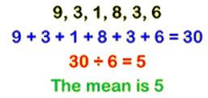
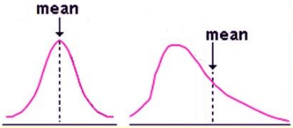
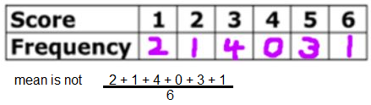
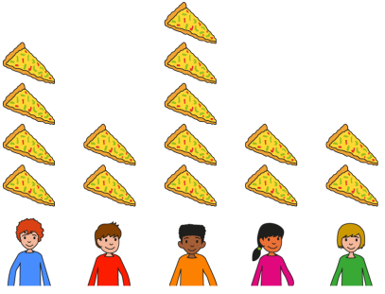
Subtopic N3.22 – The Mean
LEARNING OUTCOME: To understand what the mean is and how to apply it to different contexts.
Objectives:
Keywords:
Average
Mean
Outlier
To be able to find the mean from a list of numbers.
To be able to use the mean to find missing numbers.
To be able to solve problems where the mean changes.
Introduction:
The "mean" is a way to find the average of a group of numbers. One way to think about it is as a
method for sharing things evenly. Imagine dividing a total amount equally among everyone—this is the
idea behind the mean. For example, if three friends have 8, 10, and 12 sweets, you’d add them
Together (8 + 10 + 12 = 30 sweets). Then, divide the total (30) by the number of friends (3). Everyone
would get 10 sweets if they shared equally, so the mean is 10. This idea works for numbers too, not
just sweets! The mean is useful because it gives a single value that represents the whole group, helping
us understand what is typical in a set of data.
Definition
Characteristics
The average value of the data.​
Can be found by sharing the total of all the numbers in the list equally between them.
Represents the point of balance if all the numbers from the list are placed on a number line.
Affected by outliers.
Examples
Mean
Non - Examples
Mean of 5, 4, 3, ≠ 5 + 4 + 3 ÷ 3
We can think of the mean as redistributing things equally.
For example:
5 people have different amounts of pizza:
We can redistribute them as follows, so they all have an equal share:
Now they have been redistributed equally, they have 3 slices each. Therefore, the mean is 3.

Slide 2
Finding the mean from a list of numbers
For the following questions, find the mean of the list of numbers.
Steps
1) Add the numbers together. 2) Divide by the number of values in the list.
Example 1 – I do…
Example 2 – We do…
Example 3 – You do…
6
5
8
Example 4 – I do…
Example 5 – We do…
Example 6 – You do…
4.8
5.5
8.5
Independent Practice
Question 1. Work out the mean from the following lists of data:
4
8
45
8
9
11
11
12
11.5
10.5
2.3
1.15

Slide 3
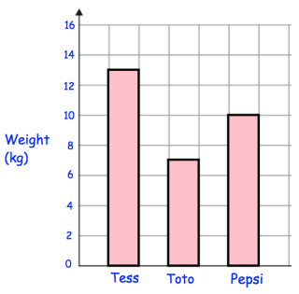
Question 2. A basketball team plays 8 matches. The number of points they score in each match are: 62, 68, 67, 79, 82, 50, 74, 62 Work out the mean number of points scored . | Question 3. Mr Holland gives his class a test. The results are: 34%, 44%, 75%, 21%, 98%, 86%, 71%, 76%, 63%, 55% Work out the mean mark.
Question 4. Five houses on a street are sold in 2016. They sell for: £175,000 £184,000 £150,000 £201,000 £191,000 Calculate the mean price. | Question 5. The length of nine caterpillars are listed below: 9cm 4cm 8cm 10cm 7cm 5cm 13cm 10cm 6cm Find the mean.
Question 6. The amount of water in some containers are: 2 litres, 330ml, 0.08 litres, 0.7 litres, 75ml, 5000ml, 0.215 litres Work out the mean. Give your answer in litres. | Question 7. Shown are the weights of 3 puppies. Work out the mean weight.
68
62.3%
£180,200
8cm
1.2litres
10

Slide 4
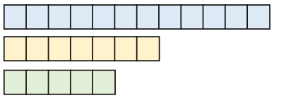
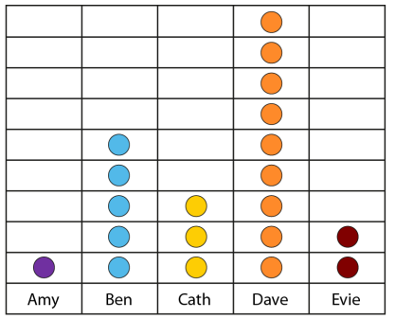
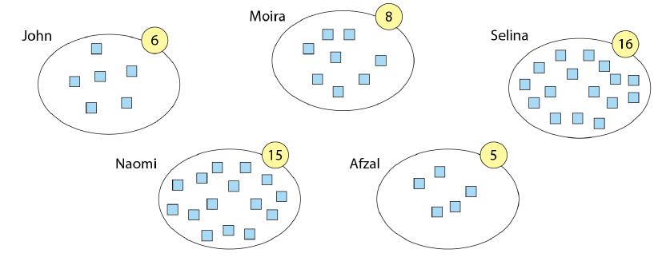
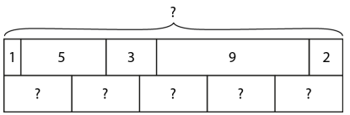
Question 9. Using your knowledge of the mean being a redistribution into equal amounts, answer the following questions:
a) Alex has 12 cubes, Bilal has 7 cubes and Carlos has 5 cubes. If they were to redistribute the cubes so they each have the same amount of cubes, how many cubes would each of them get?
b) Amy has one card, Ben has five cards, Cath has three cards, Dave has nine cards and Evie has two cards. How many do they have if they each share them equally?
c) John, Moira, Selina, Naomi and Afzal each have some cubes. If the cubes were to be reorganised so that each child had the same amount of cubes, how many cubes would they each have?
d) Here is a bar model with some values. Redistribute the amounts into equal boxes. What number goes in each box?
8
4
10
4

Slide 5
Depth: Using the mean to find missing numbers
Example 7 – I do…
Example 8 – We do…
Example 9 – You do…
Steps
1) Multiply the mean by the number of values. 2) Subtract the given numbers in the list away from this total.
8
6
5
Example 10 – I do…
Example 11 – We do…
Example 12 – You do…
Steps | Four numbers have a mean of 10. Three of the numbers are 8, 15, 7. What is the fourth number? | Five numbers have a mean of 10. Four of the numbers are 8, 15, 7, 8. What is the fifth number? | Six numbers have a mean of 10. Five of the numbers are, 8, 15, 7, 8, 9. What is the sixth number?
1) Multiply the mean by the number of values. 2) Subtract the given numbers in the list away from this total.
10
12
13
Independent Practice
Question 10. Work out the missing number from the list.
2
6
3
6
55
46
‹#›

Slide 6
66
28.5
13
Question 11. Work out the missing number from the list.
a) Four numbers have a mean of 22. The first three are 20, 28 and 25. What is the fourth number? | b) Four numbers have a mean of 2.2. The first three are 2.0, 2.8, 2.5. What is the fourth number?
c) Five numbers have a mean of 22. The first four are 20, 28, 25, 17. What is the fifth number? | d) Five numbers have a mean of 44. The first four are 40, 56, 50 and 34. What is the fifth score?
15
1.5
20
40
e) Five numbers have a mean of 11. The first four are 10, 14, 12, 9. What is the fifth number? | f) Four numbers have a mean of 15. The first three are 15, 15, 15. What is the fourth number?
g) Four numbers have a mean of 15. The first three are 20, 20, 20. What is the fourth number? | h) Four numbers have a mean of 15. The first three are 0, 30, 30. What is the fourth number?
10
15
0
0
‹#›

Slide 7
Solving problems where the mean changes
Example 13 – I do…
Example 14 – We do…
Example 15 – You do…
Steps | The mean of 4 numbers is 6. Another number is added and the mean is now 5. What number was added? | The mean of 4 numbers is 10. Another number is added and the mean is now 8. What number was added? | The mean of 4 numbers is 8. Another number is added and the mean is now 7. What number was added?
1) Multiply the new mean by the new number of values. 2) Multiply the original mean by the original number of values. 3) Subtract these.
1
0
3
Independent Practice
a) The mean of 3 numbers is 15. Another number is added and the mean is now 12. What number was added? | b) The mean of 9 numbers is 1.5. Another number is added and the mean is now 1.6. What number was added?
c) The mean of 5 numbers is 8. Another number is added and the mean is now 6. What number was added? | d) The mean of 5 numbers is 30. A number is taken away. The mean of the 4 remaining numbers is 25. What number was taken away?
Question 12.
3
2.5
6
50
‹#›

Slide 8
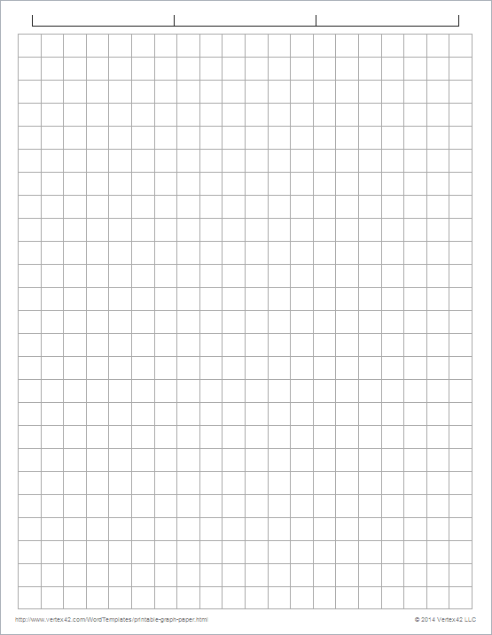
d) Hertford Juniors is a basketball team. At the end of 10 games, their mean score is 35 points per game. At the end of 11 games, their mean score has gone down to 33 points per game. How many points did the team score in the 11th game? | e) Nigel has scored a mean of 18 runs in the last five cricket matches. His mean score must be 20 or more for him to be chosen for the school team. Find the number of runs that he must make in the next match if he is to be chosen for the school team.
f) Buster is taking part in a dog competition. There are 6 rounds, each worth 20 points. The mean of Buster’s scores for the first 5 rounds is 13 points. If a dog has a mean score of 14 points or more, after the 6 rounds, they will receive a prize. Find the lowest possible number of points that Buster needs, in the final round in order to win a prize. | g) John has scored a mean of 0.4 goals in the last 10 football matches for the B team. His mean score must be 0.5 or more for him to be chosen to play for the A team. Find the minimum number of goals that he must score in the next match if he is to be chosen for the A team.
13
30
19
1.5 so 2

Slide 9
Example 16 – I do…
Example 17 – We do…
Example 18 – You do…
Steps | The mean of 5 numbers is 8. The number 2 is added. What is the mean now? | The mean of 6 numbers is 5. The number 12 is added. What is the mean now? | The mean of 3 numbers is 8. The number 4 is added. What is the mean now?
1) Multiply the mean by the number of values to get the total. 2) Add on the new values. Divide by how many values there are now.
7
6
7
Independent Practice
Question 13.
a) The mean age of 2 girls is 8. Another girl joins, age 5. What is the mean age of the 3 girls? | b) The mean number of goals scored by 3 players is 18. Another player joins, having scored 6 goals. What is the mean number of goals scored by the 4 players?
c) The mean heights of 24 men is 1.64m. Another man has a height of 1.89m. What is the mean height of the 25 boys? | d) The mean age of a team if 25 players is 26. One of the players, age 20, is sold. What is the mean age of the team now?
e) The mean age of 3 students is 15 years old. Another student joins the group, aged 16. What is the mean age of the 4 students? | f) The mean age of 4 students is 12 years old. Another student joins the group, aged 16. What is the mean age of the 5 students?
g) Mark ran a mean distance of 13.2 km in five days. The next day Mark ran 20 km. Find the mean distance Mark ran in the six days. | h) Pete has seven Shetland ponies. They have a mean height of 116cm. Pete buys an eighth pony. The height of this pony is 128cm. Find the mean height of all eight ponies.
7
15
1.65
26.25
15.25
12.8
14.56333…
117.5

Slide 10
i) The mean height of a squad of 24 rugby players is 185cm A new player joins the squad who has a height of 170cm Work out the new mean height of the squad. | j) The mean height of seven pupils is 123cm. One pupil of height 147cm leaves the group. Find the mean height of the remaining six pupils.
184.4
119
Question 14. In the first row of the table, the mean for a set of data has been calculated. For each question, first predict whether you think the mean will increase, decrease or stay the same. Then calculate the mean and compare this with your prediction.
Data | Prediction | Mean | Was your prediction correct?
2, 2, 4, 5, 7 |  | 4
a) 2, 2, 4, 5, 12 |  | 5
b) 3, 3, 5, 6, 13 |  | 6
c) 6, 6, 10, 12, 26 |  | 12
d) 6, 6, 10, 18, 20 |  | 12
e) 6, 6, 13, 15, 20 |  | 12
f) 6, 6, 13, 15, 20, 24 |  | 14
g) 0, 6, 6, 13, 15, 20, 24 |  | 12

Slide 11
Example 19 – I do…
Example 20 – We do…
Example 21 – You do…
Steps | The mean of 7 numbers is 3. The mean of a different 3 numbers is 5. What is the mean for all of the numbers? | The mean of 5 numbers is 3. The mean of a different 3 numbers is 5. What is the mean for all of the numbers? | The mean of 6 numbers is 4. The mean of a different 4 numbers is 8. What is the mean for all of the numbers?
Multiply the first mean by the total values in its set. Multiply the second mean by the numbers in that set. Add your answers. Divide by the total number of values.
3.6
3.75
5.6
Independent Practice
Question 15.
a) The mean age of 9 boys is 10. The mean age of 9 girls is 15. What is the mean age of all the boys and girls? | b) A group of students take a test. The group consists of 12 boys and 8 girls. The mean mark for the boys is 18. The mean mark for the girls is 16.5 Calculate the mean` mark for the whole group.
12.5
17.4
c) Don delivers pint bottles of milk to two streets. For the first street of 10 houses, the mean number of bottles of milk he delivers is 3.1. For the second street of six houses, the mean number of bottles he delivers is 2.5. Find the mean number of bottles of milk he delivers per household for the two streets altogether. | d) There are 12 students in Phil’s Maths group. The mean mark in a test is 76%. In Paul’s group there are only eight students. Their mean mark is 84%. Find the overall mean for the 20 children.
2.875
79.2

Slide 12
d) The mean of eight numbers is 46. The mean of three of the numbers is 32. What is the mean of the other five numbers? | e) The mean of twenty numbers is 8. If four of those numbers have a mean of 10, what is the mean of the other sixteen numbers?
f) The mean of four numbers is 2.6. One of the four numbers is 5. Find the mean of the other three numbers. | g) The mean of 10 numbers is 48. If one of the numbers is 50, what is the mean of the other nine?
h) The mean of eight numbers is 41. The mean of two of the numbers is 29. Work out the mean of the other six numbers. | i) There are 10 boys and 10 girls in a class. The mean mark for the class test for the girls is 54. The mean mark for the class is 60. Work out the mean mark for the boys.
54.4
7.5
1.8
47.777…
45
66
j) 4 adults and 6 children have a mean age of 21.8. The adults have a mean age of 35. What is the mean age of the children? | k) 8 girls have a mean score of 45%. There are 20 students in total. The total class mean score was 40%. What was the mean score of the boys?
13
36.666…

Slide 13
l) A class of 30 boys and girls sit a test. The mean mark for the 14 boys is 76% The mean mark for the whole class is 78% Work out the mean mark of the girls | m) 20 men, 10 women and 10 children are in a competition. The mean score for the women is 15.6. The mean score for the children is 9.2. Kevin says that the mean score for all 40 people is 11.2. Work out the mean score for the men.
n) Two parents have 3 daughters and 2 sons. The mean age of the family is 18. The mean age of the daughters is 13. The mean age of the sons is 10. The mother is 3 years younger than the father. How old is the father? | o) Team A consists of 13 players with a mean age of 26. Team B has 11 players with a mean of 28. A player leaves Team A to join Team B. The new mean of Team A is 26.5. What is the new mean of Team B?
79.75
10
35
27.5
Skills Check
What is the mean of the set of scores? 3, 4, 5, 6, 6, 8, 8, 8, 15 6 B) 7 C) 8 D) 9
The mean weight of six people is 60kg. One person leaves and the average weight of the remaining five people is 56kg. What was the weight of the person who leaves? 80kg B) 54kg C) 304kg D) 58kg | The mean of a set of 5 scores is 62. What is the new mean after a score of 14 is added? 38 B) 54 C) 62 D) 76

